Slide 1

Automotive Technology: A Systems Approach, 8e
Chapter 41: Automatic Transmissions and Transaxles
Rob Thompson and Jack Erjavec, Automotive Technology: A Systems Approach, 8th Edition. © 2025 Cengage. All Rights Reserved. May not be scanned, copied or duplicated, or posted to a publicly accessible website, in whole or in part.

Slide 2
Chapter Objectives (1 of 3)
41.01 Explain the basic design and operation of standard and lockup torque converters.
41.02 Describe the design and operation of a simple planetary gearset.
41.03 Describe the construction and operation of common compound planetary gearsets used in transmissions and transaxles.
41.04 Describe the construction and operation of CVTs.

Slide 3
Chapter Objectives (2 of 3)
41.05 Name the major types of planetary gear controls and explain their basic operating principles.
41.06 Describe the types and operation of different one-way clutches used in transmissions and transaxles.
41.07 Describe the types and operation of bearings, snap rings, washers, gaskets, and seals used in transmissions and transaxles.

Slide 4
Chapter Objectives (3 of 3)
41.08 Identify and explain the final drive components used in transaxles.
41.09 Describe what components are used to shift gears and their effect on shift quality.
41.10 Identify the various pressures in the transmission, state their purpose, and tell how they influence the operation of the transmission.

Slide 5
Automatic Transmissions and Transaxles
Selects gear ratios according to engine speed, power train load, vehicle speed, and other operating factors
Older units have four or five speeds.
Current units have six to ten speeds.
Some have zero fixed ratios (CVT).

Slide 6
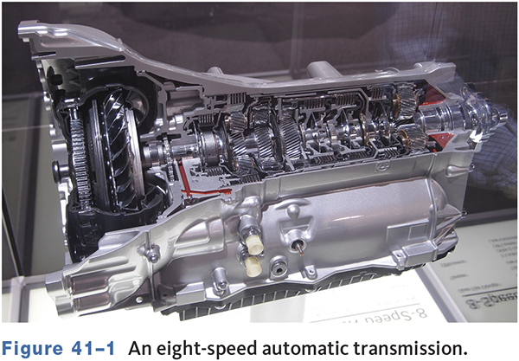
An Eight-Speed Automatic

Slide 7
Torque Converter
41.01 Explain the basic design and operation of standard and lockup torque converters.
A fluid clutch or coupling that transfers torque from the engine to the transmission
Automatically engages and disengages power from the engine in relation to RPM
Operates through hydraulic force provided by automatic transmission fluid

Slide 8
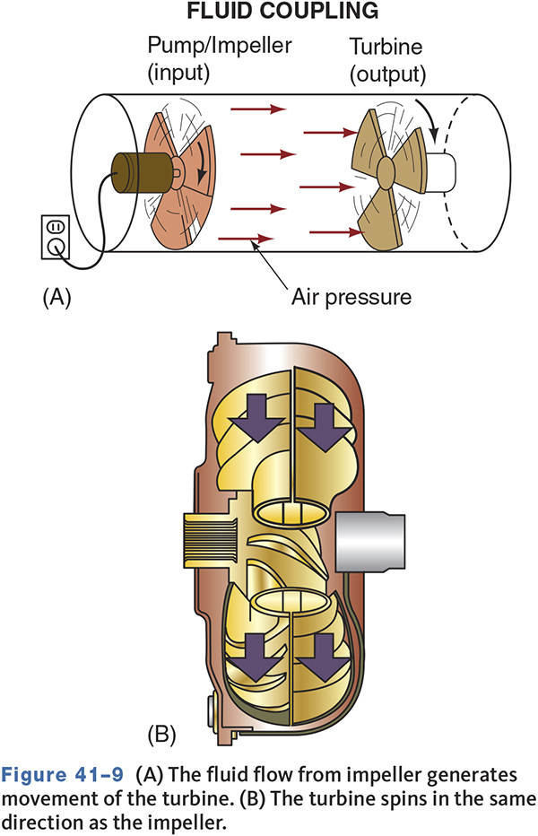
Torque Converter Operation
At idle, there is not enough fluid flow for power transfer.
As RPM increases, fluid flow is sufficient to transmit engine power.

Slide 9
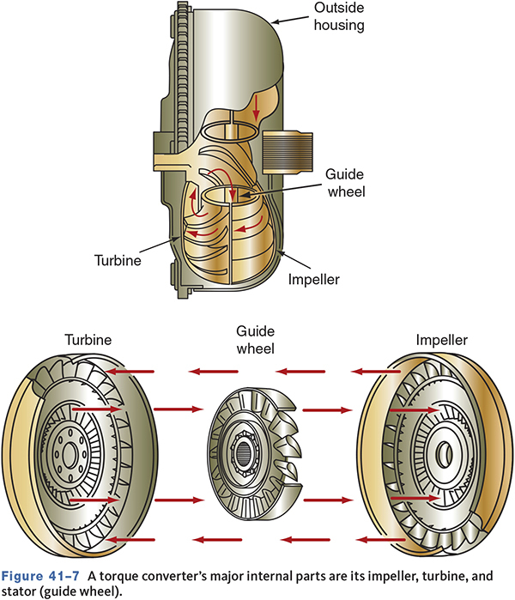
Torque Converter Components
Impeller or Pump Assembly
  Receives power from engine
Turbine
  Output member
Stator
  Guide wheel

Slide 10
Types of Oil Flow
Rotary Flow
  Oil flow around the circumference caused by rotation of the torque converter on its axis.
Vortex Flow
  Oil flow from the impeller to the turbine and back to the impeller.
Coupling point is when turbine speed approaches impeller speed.

Slide 11
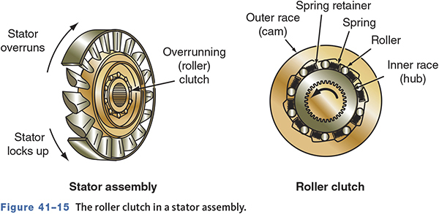
Roller Clutch in a Stator

Slide 12
Lockup Torque Converter
Eliminates the 10 percent slip between the impeller and turbine.
Improves fuel economy.
Reduces operational temperature.
Most torque converter clutches (TCC) use electronically controlled hydraulic pistons.

Slide 13
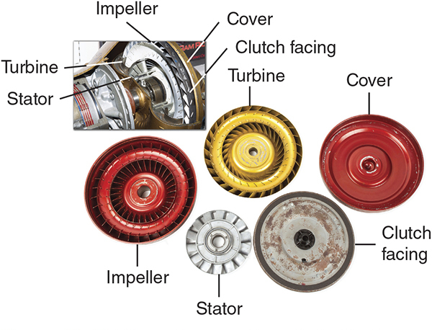
Lockup Clutch

Slide 14
Knowledge Check (1 of 4)
Technician A says the overrunning clutch is part of the stator. Technician B says the overrunning clutch is part of the lockup clutch. Who is correct?

Slide 15
Knowledge Check Answer (1 of 4)
Technician A says the overrunning clutch is part of the stator. Technician B says the overrunning clutch is part of the lockup clutch. Who is correct?
Answer: Technician A only

Slide 16
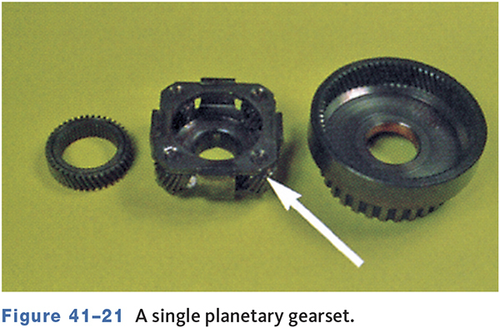
Planetary Gears
41.02 Describe the design and operation of a simple planetary gearset.
Used to transfer power and multiply torque
Compound gearsets spread the load over more teeth for increased strength and to obtain the largest number of gear ratios.
Planetary carrier may be cast iron, aluminum, or steel.

Slide 17
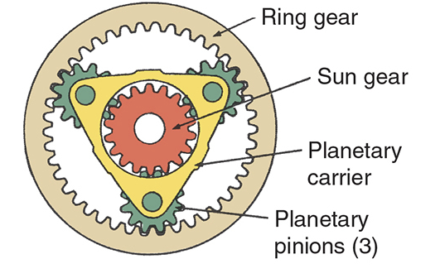
Planetary Gear Components
Ring Gear (Annulus)
  Has internal teeth.
Sun Gear
  Is located in the center of the assembly.
Planetary Carrier
  Holds the planetary pinion gears.

Slide 18
Planetary Gear Operation
When the planetary carrier is the input, an overdrive condition is produced.
When the planetary carrier is the output, an underdrive condition is produced.
When the planet carrier is held, reverse gear is produced.

Slide 19
Types of Compound Gearsets
41.03 Describe the construction and operation of common compound planetary gearsets used in transmissions and transaxles.
Simpson
  Has two separate planetary gearsets with a common sun gear.
Ravigneaux
  Has two separate sun gears, two separate planetary gears, and a common ring gear.

Slide 20
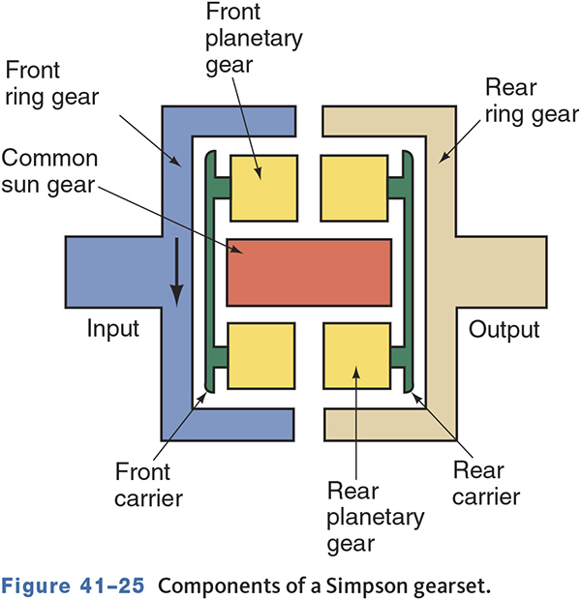
Simpson Gearset

Slide 21
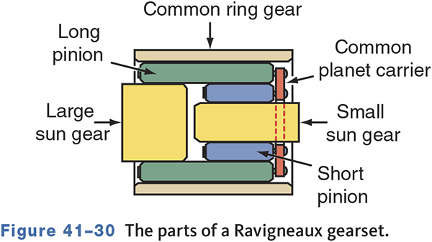
Ravigneaux Gearset

Slide 22
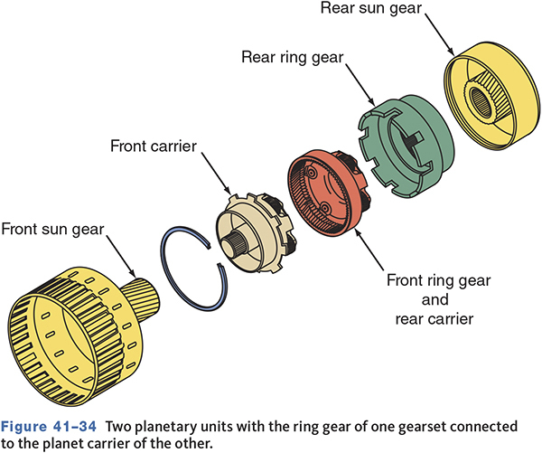
Planetary Gearsets in Tandem
Some transmissions use two simple planetary gearsets in series.
Gearset members are not shared.
Each member has a holding device.

Slide 23
Lepelletier System
Used on some six, seven, eight, and nine speed transmissions.
Many are more compact than most four- and five-speed automatics.
Connects a simple planetary gearset to a Ravigneaux gearset.
The simple gearset is used as the input.

Slide 24
Other Transmission Designs
Nonplanetary Gearset Type
  Uses constant mesh gears similar to a manual transmission.
Continuously Variable Type (CVT)
  Has no fixed forward speeds.
  Uses belts and pulleys to provide variable ratios.

Slide 25
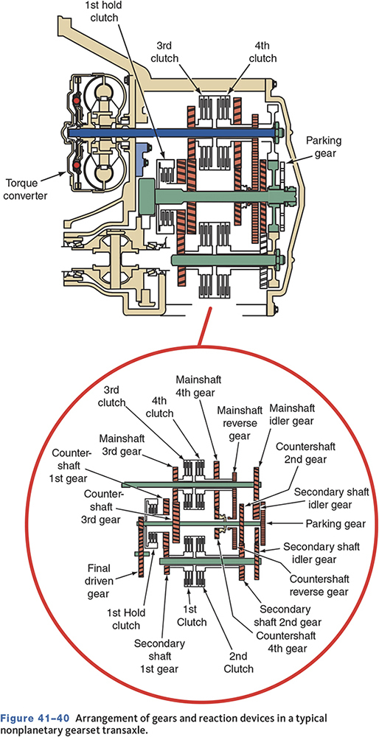
Typical Nonplanetary Transaxle

Slide 26
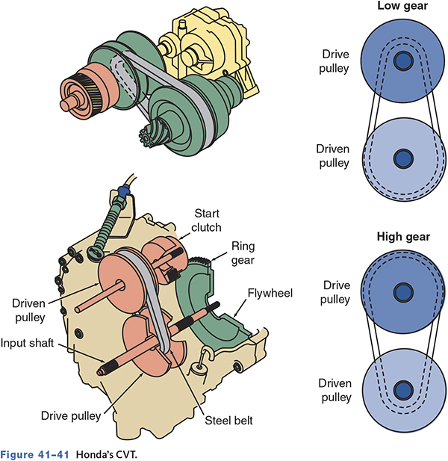
CVT Transmission
41.04 Describe the construction and operation of CVTs.

Slide 27
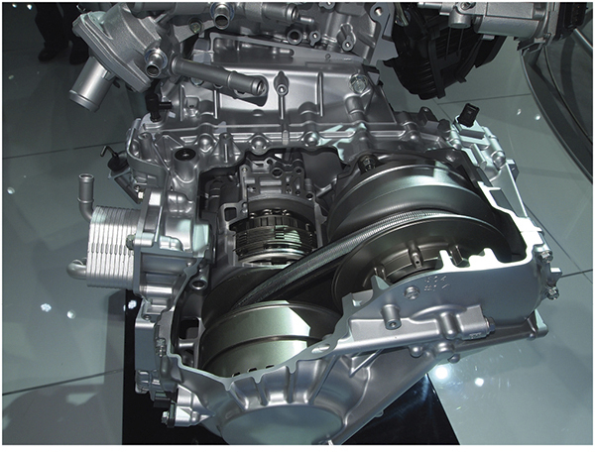
CVTs use pulleys

Slide 28
CVT Controls
Controls consist of the TCM, input sensors, and solenoids.
A shift control valve controls pressure applied to the drive and driven pulleys.

Slide 29
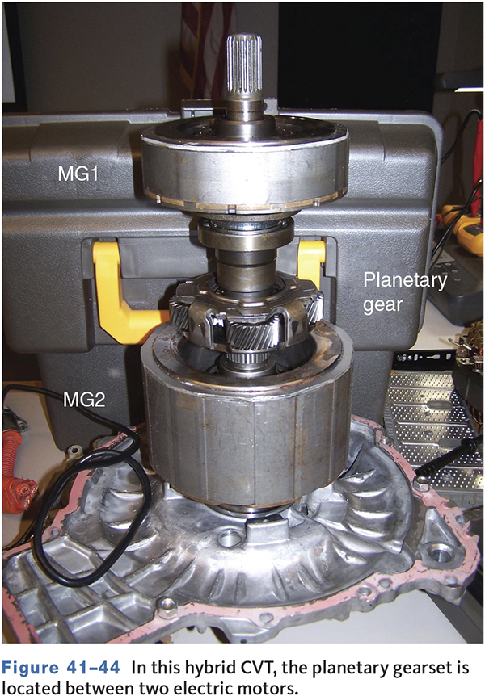
Planetary Gear-Based CVTs
Used in Toyota and Ford hybrid vehicles
Contains the motor/generators and planetary gearset
Used in the 2Mode HEV transmission

Slide 30
Knowledge Check (2 of 4)
What are the three gears that make up a planetary gearset?

Slide 31
Knowledge Check Answer (2 of 4)
What are the three gears that make up a planetary gearset?
  Answer: Sun, planetary, and ring or annulus

Slide 32
Apply Devices
41.05 Name the major types of planetary gear controls and explain their basic operating principles.
Bands
  Are typically used as a holding device.
Servos
  Are used to apply the band.
Multiple Friction Disc Assemblies
  Are used to hold or apply.

Slide 33
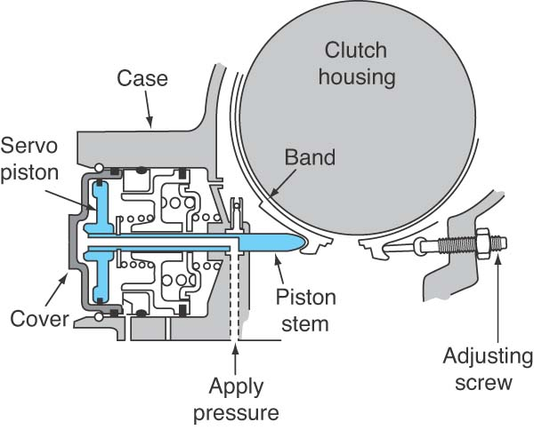
Transmission Bands
A braking assembly positioned around a stationary or rotating drum or carrier.

Slide 34
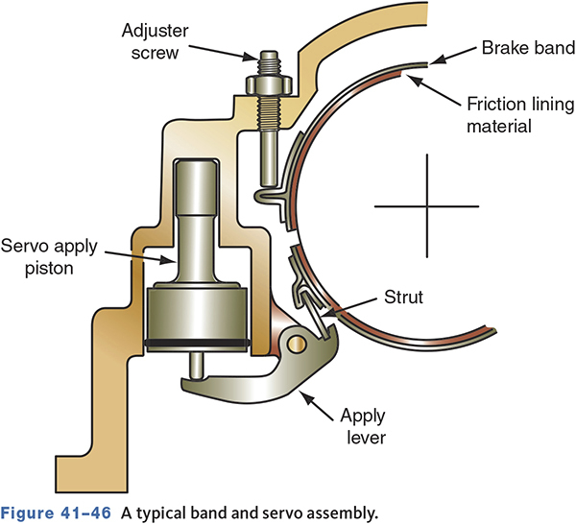
Transmission Servos
Covert hydraulic pressure into a mechanical force that applies a band.
Simple servos are released by spring pressure.
Compound servos are released and held by fluid pressure.

Slide 35
Knowledge Check (3 of 4)
Technician A says a band is used to keep a drum from rotating. Technician B says a band is applied by a servo. Who is correct?

Slide 36
Knowledge Check Answer (3 of 4)
Technician A says a band is used to keep a drum from rotating. Technician B says a band is applied by a servo. Who is correct?
  Answer: Both technicians A and B

Slide 37
Transmission Clutches
41.06 Describe the types and operation of different one-way clutches used in transmissions and transaxles.
Able to hold and drive planetary gear members.
Both sprag and roller overrunning clutches are used.
Overrunning Clutches
  Can be used to hold or apply members of the gearset.
  Are typically used as a holding device.

Slide 38
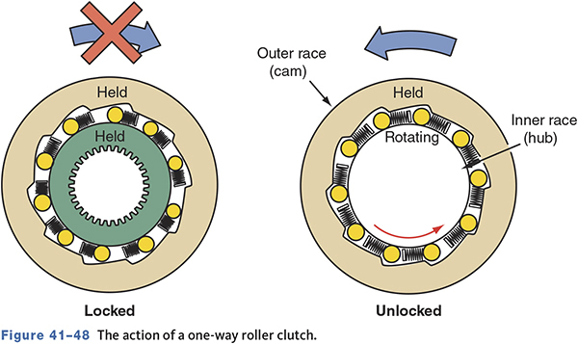
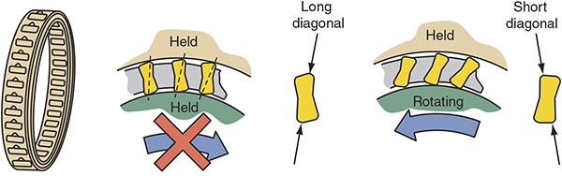
One-way Roller Clutch and Sprag-type

Slide 39
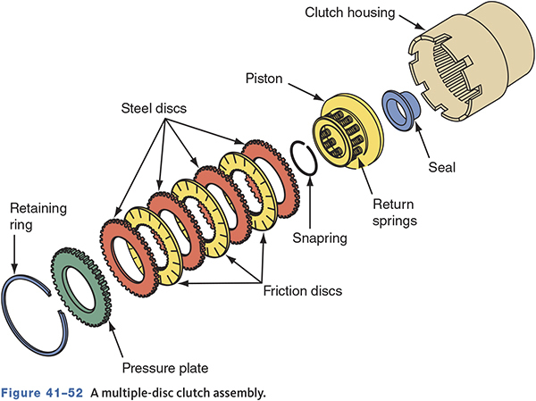
Multiple-Disc Clutches
A series of friction discs and steel plates used to transmit torque or apply braking force.
Internal teeth mesh with clutch hub.
External teeth mesh with internal splines in transmission housing or clutch drum.

Slide 40
Bearings, Bushings, and Thrust Washers
41.07 Describe the types and operation of bearings, snap rings, washers, gaskets, and seals used in transmissions and transaxles.
Bearings are used to reduce wear and friction.
  Most either slide or roll against the surface.
Bushings are pressed into place.
  Support rotating parts, guide parts, and control fluid flow.
Thrust washers may act as a bearing and a spacer to control endplay.

Slide 41
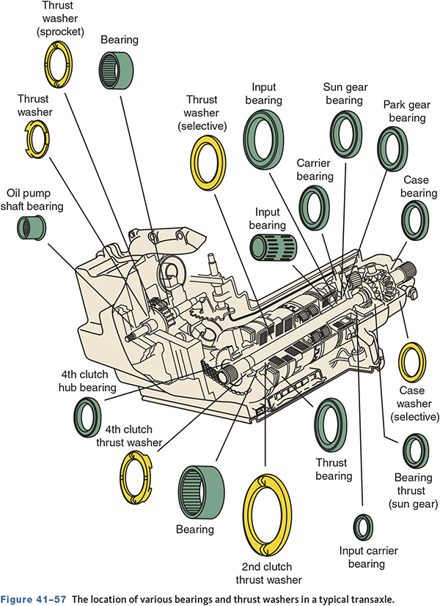
Typical Bearing Locations

Slide 42
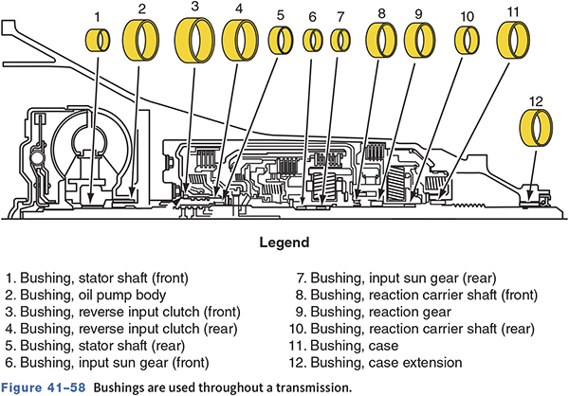
Bushing Locations

Slide 43
Seal Classifications
Static
  Is used between two parts that do not move.
Dynamic
  Is used between two parts that move with either rotating or reciprocating motion.
Positive
  Prevents all fluid leakage.
Non-positive
  Allows a controlled amount of leakage.
  Is used to lubricate a moving part.

Slide 44
Final Drive Assemblies
Transmit transaxle output to the differential section.
Four common configurations:
  Helical gear
  Planetary gear
  Hypoid gear
  Chain drive

Slide 45
Knowledge Check (4 of 4)
Which of the following is NOT a type of apply device?
  a. Overrunning clutch
  b. Band
  c. Multidisc clutch
  d. Planetary gear

Slide 46
Knowledge Check Answer (4 of 4)
Which of the following is NOT a type of apply device?
  a. Overrunning clutch
  b. Band
  c. Multidisc clutch
  d. Planetary gear
  Answer: d. Planetary gear

Slide 47
Hydraulic System
The fluid operates, lubricates, and cools the transmission.
The pump is the source of all fluid flow.
  Pressure—regulating valves change fluid pressure to control shift quality and shift points.
  Flow—directing valves send to fluid to the correct apply device for gear changes.

Slide 48
Hydraulic System Elements
Fluid reservoir
  Oil pan
Pressure source
  Pump
Vent
  Necessary to draw fluid into the pump
Transmission cooler
  Removes excessive heat
Control valves
  Valve body
Output devices
  Apply devices

Slide 49
Functions of ATF
Cools the transmission.
Cleans internal parts.
ATF under pressure forces valves to move.
Used to operate clutches and other apply devices.

Slide 50
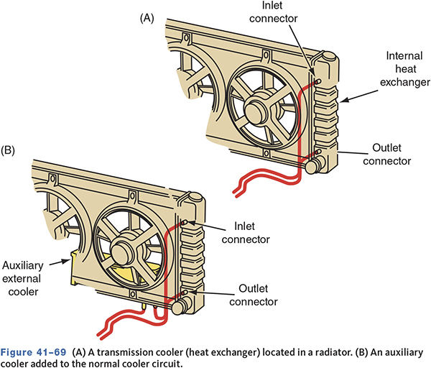
Transmission Coolers
Remove heat from the ATF.
May be incorporated into the radiator.
May have separate cooler.
Lines connect the transmission and cooler.

Slide 51
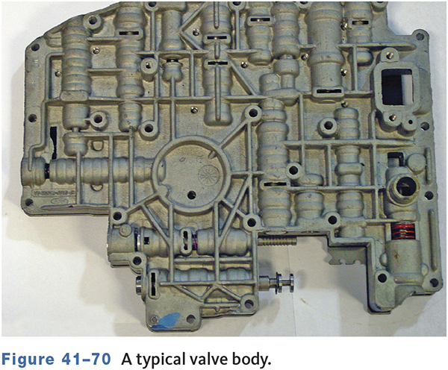
Valve Body
Distributes and controls pressurized fluid throughout the transmission.
Made of two or three main components
  Valve body
  Separator plate
  Transfer plate

Slide 52
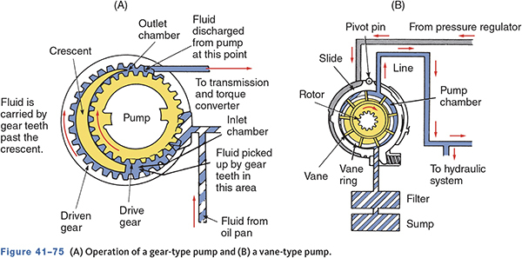
Oil Pumps
Driven by the drive hub of the torque converter.
Gear and vane-type pumps are common.
Variable displacement pumps used in some transmissions.

Slide 53
Monitoring Engine Load
MAP and throttle position sensors
  Used to monitor engine load.
  Increased engine load requires changes in transmission operation.
Pressure controlled by EPC solenoid.

Slide 54
Gear Changes (1 of 2)
Gear changes occur either automatically or at the command of the driver.
The transmission cannot shift into park, reverse, or neutral by itself.

Slide 55
Gear Changes (2 of 2)
Park
  When park is selected, the park pawl or lever engages the park gear.
Reverse
  The manual shift valve allows fluid to flow to the low/reverse band.
Drive range
  Front clutch engages.
  The shift valve controls upshifting into higher gears.

Slide 56
Chapter Reflection
Describe the concept from this chapter that challenged you the most. Describe what made the concept difficult for you and the steps you took to improve your understanding.
How could you help another learner who was struggling with the same concept.
Use 100–150 words in your answer.

